Slide 1
Urinov Azizbek 20162672
Computer Engineering (Final Website)

Slide 2
Delivery of Halal Food
In South Korea

Slide 3



Delivery of Halal Food- my website isn’t online food ordering website. We are between restaurants and
Costumers. We didn’t take any orders from customers, we just connect with restaurants and deliver food to customers.
Delivery of Halal Food

Slide 4
Why I create this website?
Not all restaurants have delivery service.
Our service very fast
just food delivery not other
All foods are Halal

Slide 5
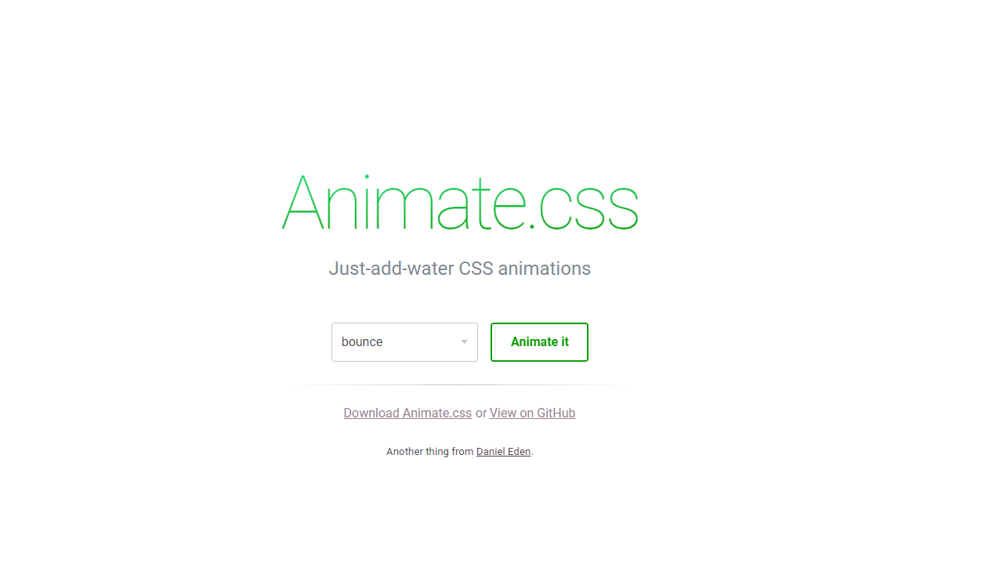
CSS
HTML
JavaScript
Overall (7 pages- welcoming,main,sign, team,about,event mode,press and contact)
All codes are create by myself using (YouTube and Google Tutorials) Udemy and Newboston
(CSS) Animation among pages did not create by myself. (https://daneden.github.io/animate.css/)
Animate.css is download and use in my webpage.

